Slide 1
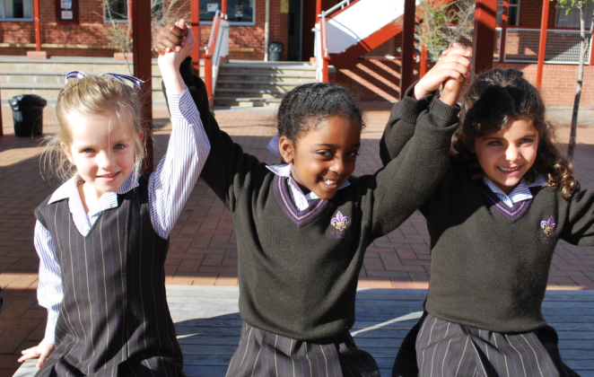
Year 4's stand out the front
Talia: Please join us in our opening hymn
Together As One
Chorus:
Let us come (Let us come)
Together as one(Together as one)
We will sing (la la la la)
And praise his name (alleluia!)
1. We come to pray, we come to sing
We come today, to share everything.
2. Together in Christ, God's only son
Together with him, and love everyone.
3. Let's sing in praise, let's sing for joy
Every woman, every man
Every girl, every boy
4. Praise our God, Jesus the Son
The Holy Spirit
And praise them one

Slide 2
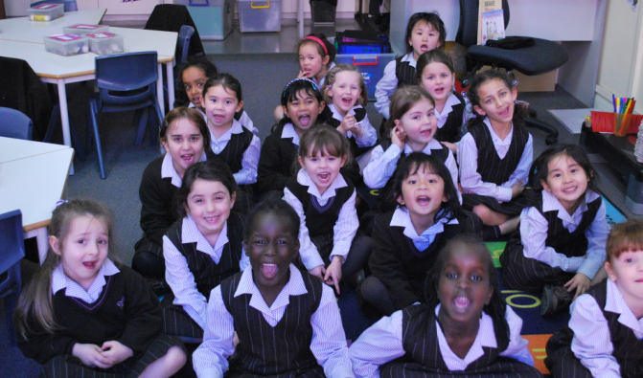
Reader: Can everyone join in and sing I could sing of your love forever?
I Could Sing of Your Love Forever
Over the mountains and the sea; Your river runs with love for me; And I will open up my heart ; And let the Healer set me free.
I’m happy to be in the truth; And I will daily lift my hands; For I will always sing of when Your love came down;
I could sing of Your love forever; I could sing of Your love forever;
I could sing of Your love forever; I could sing of Your love forever;
Repeat

Slide 3
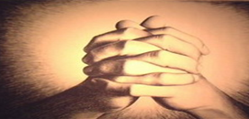
Reader: Receptions, please stand
up and lead us in prayer
Janet Mead, The Lord’s Prayer
Our Father, who art in heaven, hallowed be Thy name. Thy kingdom come, Thy will be done on earth as it is in heaven.
Our Father, who art in heaven, hallowed be Thy name.Thy kingdom come, Thy will be done on earth as it is in heaven.
Give us this day our daily bread, forgive us our trespasses,
as we forgive those who trespass against us, Forgive us our trespasses.
Our Father, who art in heaven, hallowed be Thy name. Thy kingdom come, Thy will be done on earth as it is in heaven.
Our Lord lead us not into temptation, but save us from evil
and the kingdom, the power, and the glory forever will be yours!
Our Father, who art in heaven, hallowed be Thy name. Thy kingdom come, Thy will be done on earth as it is in heaven.

Slide 4
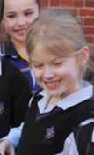
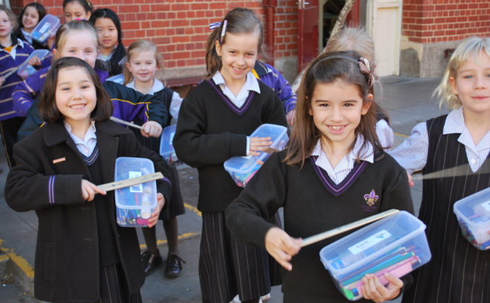
Reader: Year 3's go out the front and lead us singing Spirit of life.
Spirit of Life
We wait for each other we reach out a hand,
One step at a time we strain for a sound,
Hearts beating faster, masks coming down,
We’ll meet at the centre where life can be found.
Refrain So dance with the rhythm of the spirit of life,
Dance with the ones who are near,
Dance with the “Yes” of a song in your heart,
He is here, He is here.
If one is a wholeness made up of some parts,
and people are nothing if not side by side,
And coming together is only the start,
Of living alive, oh with nothing to hide.

Slide 5
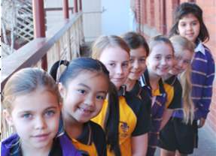
May: Please hold hands as we sing our closing hymn.
Companions on the Journey
We have been gifted with each other,
And we are called by the word of the Lord
To act with justice to love tenderly
And to walk humbly with our God
To walk humbly with our God
Chorus
Chorus: We are companions on the journey,
Breaking bread and sharing life
And in the love we bear is the hope we share
For we believe in the love of our God,
We believe in the love of our God.
No longer strangers to each other
No longer strangers in God’s house
We are fed and we are nourished
By the strength of those who care
By the strength of those who care.
Chorus

